Slide 1
CHATTING INTERFACE USING
ANDROID
Team Details
K Shruthi(20EG105419)
P Sowmya(20EG105441)
Ch.YuvaShruthik(20EG105734)
Project Supervisor Jayendra kumar.
Assistant Professor.
Department of Computer Science and
1
Engineering

Slide 2
Introduction
A one-to-one chat interface is a user-friendly platform that allows individuals to exchange messages privately, creating a seamless and engaging conversation experience.This interface will enable friends to send text messages, images, and more in real-time, fostering communication and strengthening connections.
For creating a one-to-one chat interface, you will need the following essential components: Android Studio, Flutter, Dart, Firebase
With Flutter as the front-end framework, Dart as the programming language, and Firebase as the backend, you can craft a dynamic and responsive messaging application for Android users.
APPLICATIONS: Social Networking Apps, Group Collaboration

Slide 3
Problem Statement
In the context of a chatting interface with one-to-one chatting capabilities, there exists a significant issue related to user safety and security when messages containing URLs are exchanged.
URL Safety Concerns: Users of the chatting interface have the ability to send and receive messages. However, there is currently no mechanism in place to assess the safety of URLs shared within these messages.
Risk of Malicious Content: With the prevalence of phishing attacks and the dissemination of malicious URLs, the absence of URL safety checks poses a significant risk to users. There is no way to determine if a URL shared in a message leads to a potentially harmful or dangerous website.
User Vulnerability: Users may unknowingly click on unsafe URLs shared by others, potentially compromising their privacy, security, or personal data. This vulnerability poses a direct threat to the user experience and their online safety.

Slide 4
Proposed Method
Chatting Interface
Login Page:
Users can log in with their existing accounts. Requires email and password as Input.
Successful log in redirects to the home page.
Incorrect credentials display an error message.
Sign-Up Page:
Users without accounts can create one using the Sign-Up Page.Requires email, username, and password input.
Data is stored in the database upon successful sign-up.
Home Page:
Users can engage in one-on-one chatting.
User A can send messages to User B.
User B can receive message from User A and also reply to messages.
URL Safety Check:
Url and messages are separated
URLs are automatically detected and treated differently from other text in a message. This is typically done using a technique called regular expression matching, where a pattern is defined to identify URLs within a text string. The pattern is designed to match the structure of URLs, which usually start with "http://" or "https://" and are followed by one or more characters.

Slide 5
Proposed Method
URLs in messages are sent to Google Safe Browser using API key.
Identifying malicious URLs is a complex task that often involves multiple strategies and technologies.
Method used to determine if a URL is malicious: Use of URL Scanning Services: Various online services scan and analyze URLs to determine if they are associated with malicious content. Examples include Google's Safe Browsing API, VirusTotal, and others. We can submit a URL to these services via their API to check if it has been reported as malicious.
Example using Google Safe Browsing API (you need to have an API key):
If the URL is safe, the message is forwarded.
Safe URLs are stored in a database for reference.
If the URL is malicious, a pop-up warning is generated.
This structured format provides a clear overview of the features and functionality of your chatting interface, from user authentication and messaging to URL safety checks and pop-up warnings for malicious URLs.

Slide 6
Experiment Environment
Programming language using flutter.
Android Studio and firebase for code development.
Google safe Browser to check the URLs.

Slide 7
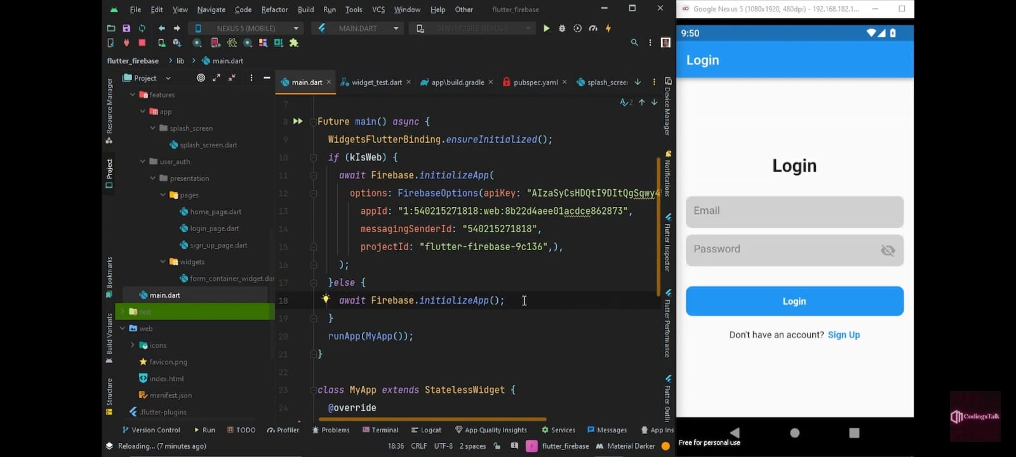
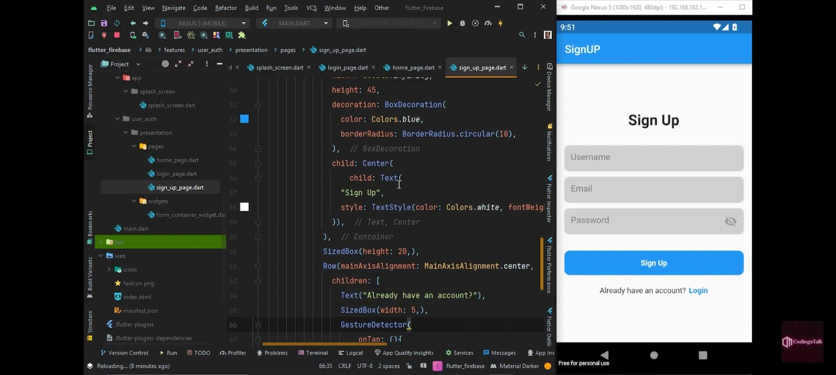
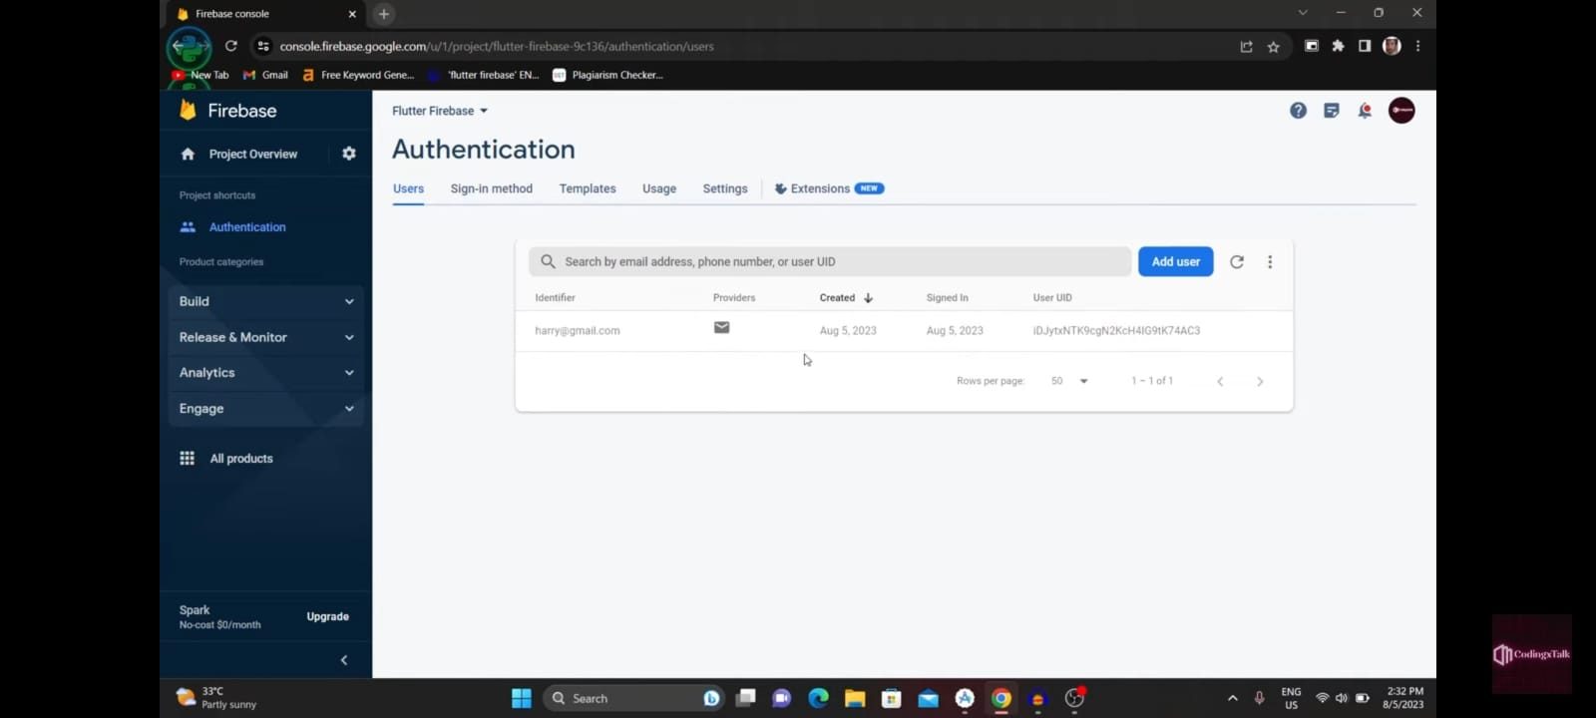
Experiment Screen shorts

Slide 8
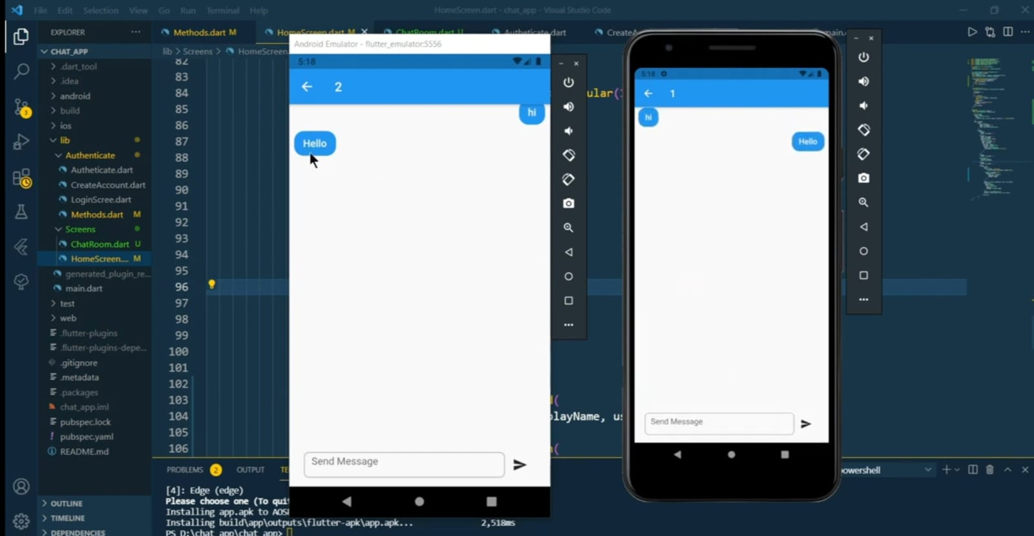
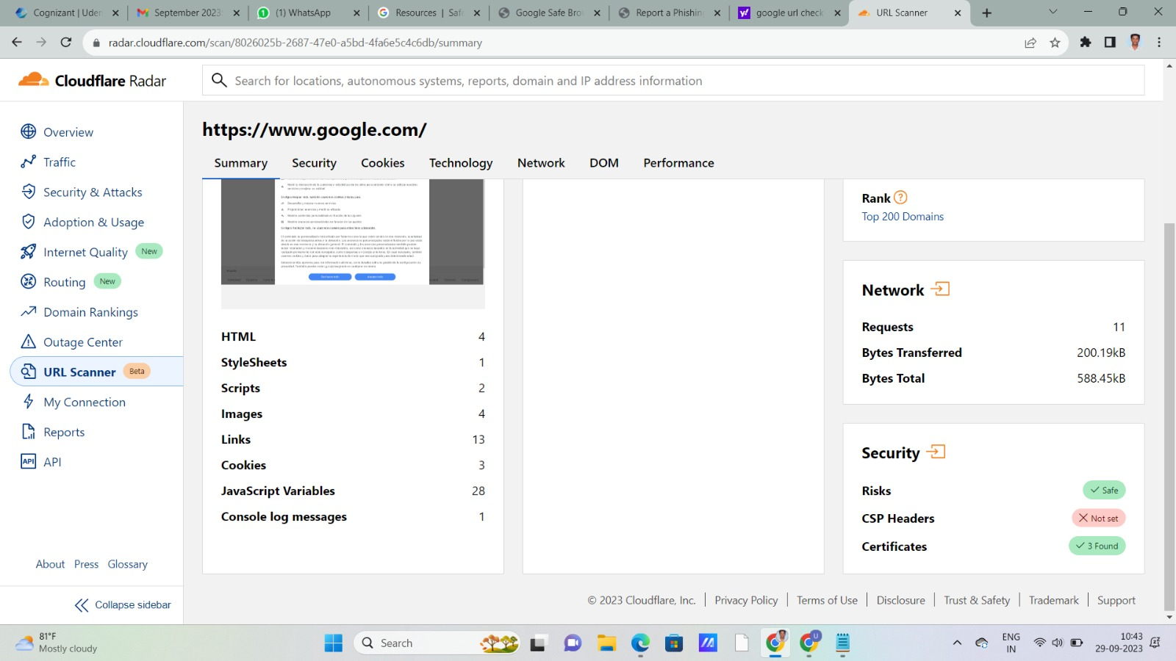
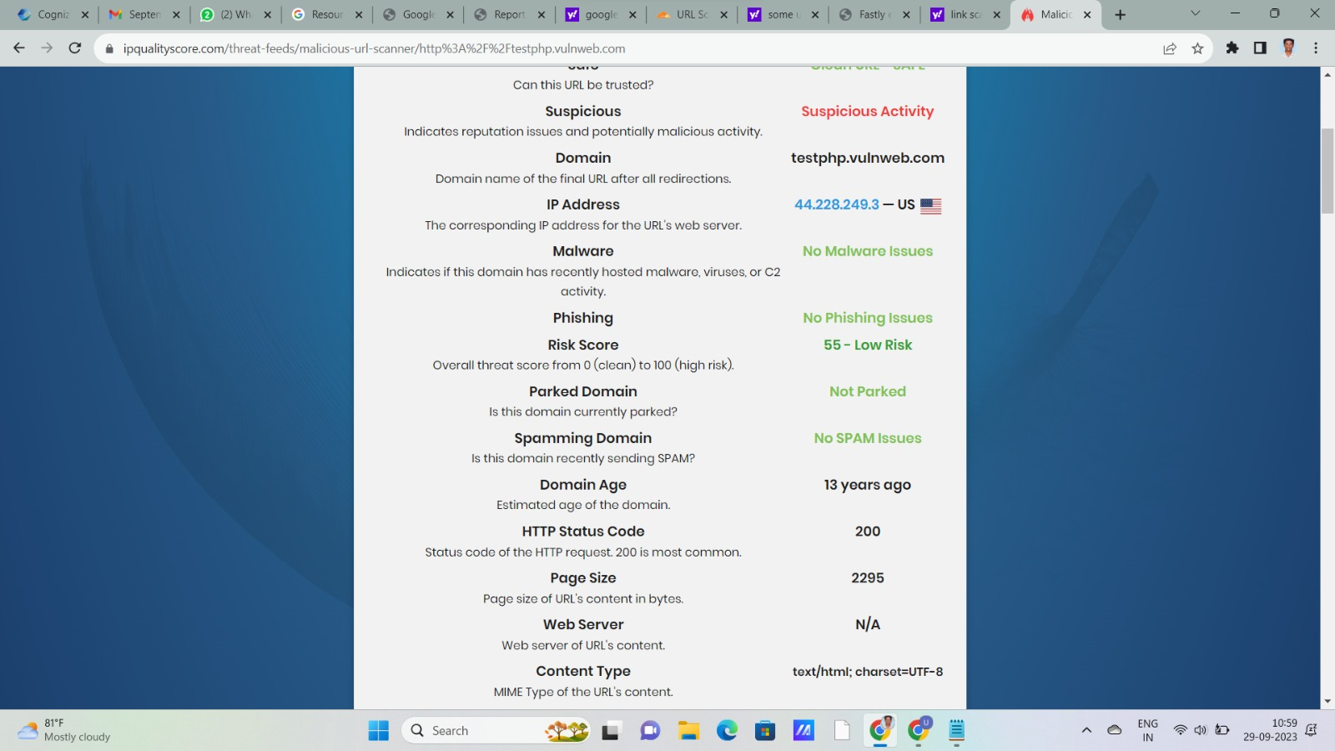
Experiment Screen shorts

Slide 9

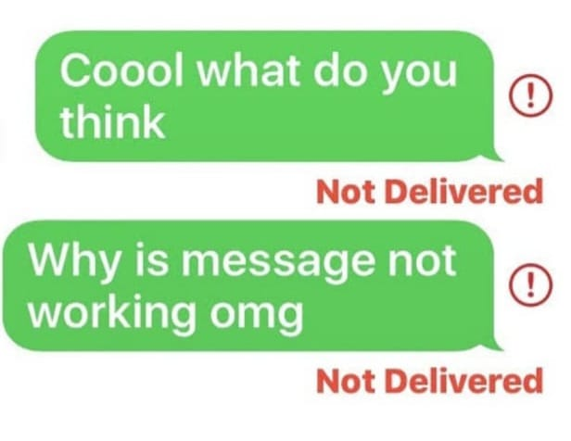
Experiment Results

Slide 10
Finding
Avoiding of phishing attack.
Through verification of URL .
Enhance security from Malware Attacks.

Slide 11
Justification
1.What are parameters improved by your method
Protecting User Privacy and Data Security: Malware and phishing attacks can compromise user data, including personal information, financial details, and confidential documents. Developing an Android app that enhances security helps protect users from these threats and secures their data.
User friendly:The improved value in this chatting interface lies in its enhanced user safety by proactively detecting and blocking malicious URLs, providing a secure and userfriendly environment for communication. This feature addresses a critical vulnerability by mitigating the risk of users inadvertently accessing harmful or phishing websites.
Scalability:The improved interface includes robust malicious URL detection. URLs shared within messages are scanned for safety, ensuring that users are protected from phishing attempts and malicious websites. Safe URLs are stored in the database, reducing the need for repetitive checks.
10

